Slide 1

Getting Started with Network Automation:
NetBox & Ansible
Rich Bibby
Technical Advocate
rbibby@netboxlabs.com

Slide 2
Today’s Goal:
Gain enough knowledge and example code to get started on your network automation journey with NetBox and Ansible!
Rich Bibby
Technical Advocate
rbibby@netboxlabs.com

Slide 3
Who am I?
Network Engineer ~20 yrs
Last few years focussed on Network Automation
Joined NetBox Labs (formerly NS1) ~18 months ago
https://www.linkedin.com/in/rich-bibby-0937112/
Rich Bibby
Technical Advocate
rbibby@netboxlabs.com

Slide 4
Agenda
Part One - Setting the scene
Why the drive for network automation?
What is a Network Source of Truth and why do we need one?
Part Two - Tooling
Modern network automation architecture
Introducing NetBox and Ansible
Part Three - Demo
Devices, data, templates & intended state in NetBox
NetBox Dynamic Inventory for Ansible
Ansible playbooks
Info gathering / device backups / reporting
Compare intended state Vs actual state

Slide 5
Agenda (continued)
Part Four - NetBox Cloud
Quick intro
Quick look at the Admin Console and new features
Part 5 - Wrap Up
Useful Resources
Q&A

Slide 6
As network complexity increases, automation becomes key to reliability
➡ Networks are becoming more dynamic and complex with more demand placed on network teams
➡ Manual processes (‘ClickOps’) are brittle and cause bottlenecks (provisioning, t-shoot)
➡ Inaccurate network data limits the ability to scale automation
65%
40%
27%
Network changes are performed manually
Gartner Market Guide for Network Automation Tools
Network operations automated by 2025
Gartner Market Guide for Network Automation Tools
Network Ops who feel they are successful(8% decrease YoY)
Network Management Megatrends 2022 - Shamus McGillicuddy, VP of Research, EMA

Slide 7
The Benefits of Network Automation (For You)
Lots of very valid business benefits, which is great…..but also…..
It’s easy to get started and you will have a lot of fun!
It will make your life easier and save you time (automate the boring stuff)
It will enhance your career (become a Network Engineering rock star!)

Slide 8
Automation requires a Network Source of Truth (NSoT)
NSoT: representation of the intended configuration and state of the devices, connections, and services of the network
Captures intended state - different than operational state
Structured, cohesive, comprehensive data model for network intent - forces completeness & correctness in design, planning, configuration management, operations

Slide 9
The journey to network automation starts with implementing a NSoT
Document
Model
Automate
Converge legacy sources of truth
Discovery or manual capture of additional network data
Change operational processes to start with documentation
Connect network data through cohesive models
Enforce consistency across models
Implement change management starting with NSoT / intent
Generate configs from model data
Drive automations from dynamic inventory
Assurance to identify/resolve operational drift

Slide 10
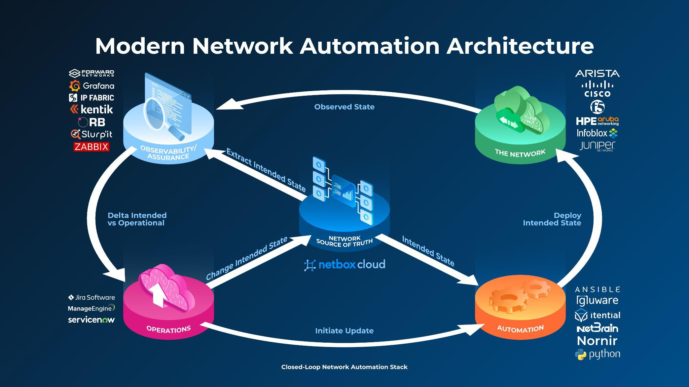

Slide 11
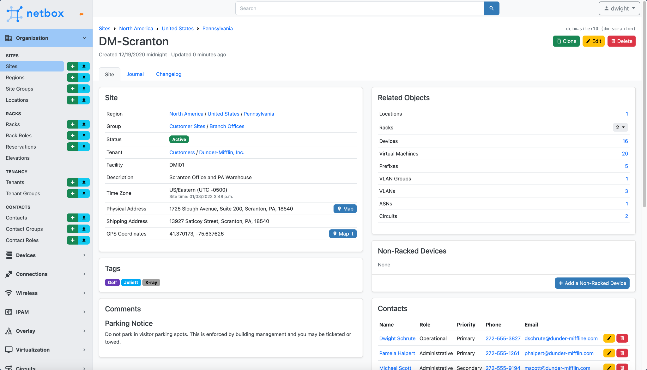
NetBox - Your Network Source of Truth
Your system of record for network management & automation:
➡ Eliminate spreadsheets
➡ Break down DCIM & IPAM data silos
➡ Accelerate network automation (REST API, GraphQL, Webhooks etc)
➡ Everything is in NetBox and everything is correlated

Slide 12






NetBox is Powered by a Massive Community
1,600+
1,000s
13k+
11k+
Networking pros building, helping, sharing - 24x7
Production installs
GitHub ⭐ Widely loved by networking teams
Software commits Feature complete, battle tested
Everyone uses NetBox

Slide 13

What is Ansible?
Open source automation tool, created as a configuration management system
Written in Python and requires Python to run
Software provisioning to application deployment
More than just a tool, it’s a force in IT orchestration
Agentless. Only SSH access is required
Human readable declarative language (YAML) - easy to outline and execute complex tasks/workflows
Extensible (modules)
Very popular as a network automation tool due to Low barrier to entry

Slide 14
Ansible Building Blocks - Configuration File
# ansible.cfg [defaults]
inventory = ./hosts.ini
host_key_checking = False
retry_files_enabled = False
ansible_python_interpreter = /usr/bin/python3

Slide 15
Ansible Building Blocks - Inventory, Group & Host Variables
# hosts.ini
---
[network_devices]
router1 ansible_host=192.168.1.1
Switch1 ansible_host=192.168.1.2
# group_vars/network_devices.yml
---
ansible_network_os: ios
ansible_user: admin
ansible_password: admin123
ansible_connection: network_cli
ansible_become: yes
ansible_become_method: enable
ansible_become_password: enablePassword
# host_vars/router1.yml
---
username: admin
password: admin12345678

Slide 16
Ansible Building Blocks - Playbooks
# show_version.yml
---
- name: Show Version
hosts: sites_container_lab
gather_facts: false
connection: network_cli
tasks:
- name: Run 'show version' command on remote devices
eos_command:
commands: "show version"
register: show_version
- name: debug
debug:
var: show_version.stdout.0

Slide 17
Ansible Architecture
Switch1
SSH
Ansible Host
Switch2
# hosts.ini
---
[network_devices]
Switch1 ansible_host=192.168.1.1
Switch2 ansible_host=192.168.1.2
Switch3 ansible_host=192.168.1.2
Switch3

Slide 18
Ansible NetBox Inventory Plugin
Dynamic retrieval of NetBox device and VM inventory data
Update NetBox = updated Ansible inventory
group_vars and host_vars can still be used alongside data from NetBox
Very flexible & well maintained

Slide 19

Ansible + NetBox Dynamic Inventory
Switch1
SSH
Ansible Host
Switch2
RESTful API
Switch3

Slide 20
Demo Environment
Network Source of Truth (NSoT)
NetBox Cloud
REST API
Network Automation Framework
Ansible
SSH
Containerized Network Devices
containerlab (cEOS)

Slide 21
Demo
Rich Bibby
Technical Advocate
rbibby@netboxlabs.com

Slide 22
What Next?
Get access to a NetBox instance:
Demo Site: https://netboxlabs.com/netbox-demo/
Free 14 Day Trial of NetBox Cloud: https://netboxlabs.com/trial/
Clone the Git repo & set up your own lab for testing (containerlab is great!)
Explore the Ansible data gathering functionality further
Develop your own reports either in markdown or html
Build more complete device templates in Jinja
Explore making configuration changes to devices with Ansible
The possibilities are endless……

Slide 23
Useful Resources
Webinar Git Repo: https://github.com/netboxlabs/netbox-ansible-webinar
Blogs:
https://netboxlabs.com/blog/getting-started-with-network-automation-netbox-ansible/
https://pynetqa.lasthop.io/blog/network-config-templating-using-ansible-part-1.html
Docs:
Ansible: https://docs.ansible.com/ansible/latest/network/index.html
NetBox: https://docs.netbox.dev/en/stable/
NetBox Inventory for Ansible: https://docs.ansible.com/ansible/latest/collections/netbox/netbox/nb_inventory_inventory.html
NetBox Cloud: https://docs.netboxlabs.com/
containerlab: https://containerlab.dev/
Jinja: https://jinja.palletsprojects.com/en/3.1.x/

Slide 24
NetBox Cloud: Admin Console and new features
Rich Bibby
Technical Advocate
rbibby@netboxlabs.com

Slide 25












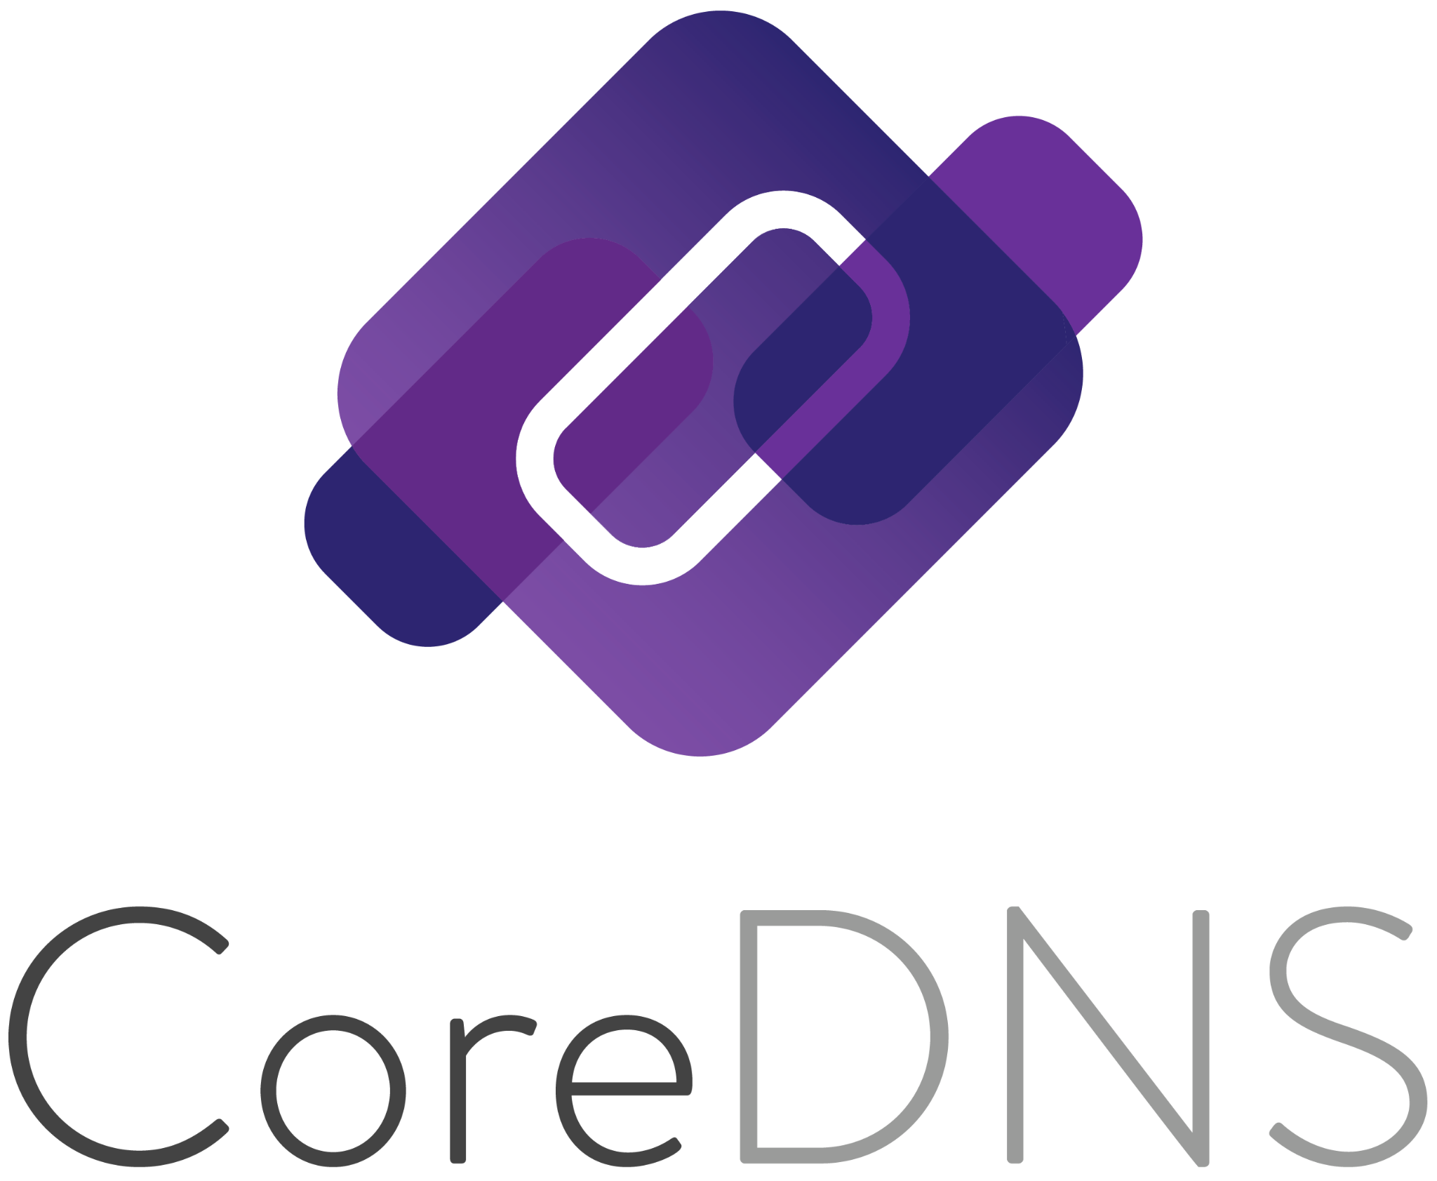






NetBox Cloud Makes Network Management & Automation Easy
Ensuring Success
24x7 support from NetBox experts & maintainers
Comprehensive onboarding, training, & integration services from NetBox Expert Partners
Engaged & accessible practitioner community
Rock Solid Platform
Enterprise SLAs
Multi-region redundancy
Single sign on
Test environments
Customizable backup policies
Custom private connectivity options
Global deployment options
Massive Ecosystem
Dozens of integrations with the tools in your stack
Technology alliances with leaders in Network Automation

Slide 26
NetBox Cloud: Run the Network, Not Your Tools
We:
Configure
Manage
Upgrade
Secure
Maintain
Optimize
Support
Your engineers:
Use NetBox to accelerate network management & automation 🚀

Slide 27








NetBox Cloud: Accelerate Network Management & Automation
“Using NetBox Cloud has created a culture shift within our IT organization that has had profound results on our ability to automate our network and better serve the many stakeholders in our community.”
Felix Windt CTO
80% fewer tickets
Tied to manual network changes at Dartmouth College after adopting NetBox
NetBox Cloud is trusted by

Slide 28
Q & A
Rich Bibby
Technical Advocate
rbibby@netboxlabs.com

Slide 29
Thank you!
Try NetBox Cloud for Free
Contact us: sales@netboxlabs.com
Join the NetBox Community

